Slide 1


Ionic Capacitor QR-Code Scanner
khirulnizam.com

Slide 2



Agenda
Generate QRCode using qrcode generator
Create new Ionic Project
FormGroup to hold data from scan
QRCode Scanner Ionic Plugins
AndroidManifest camera uses-permission
Handling scan process
Handling stop scan
Capture scanned data send to input form

Slide 3
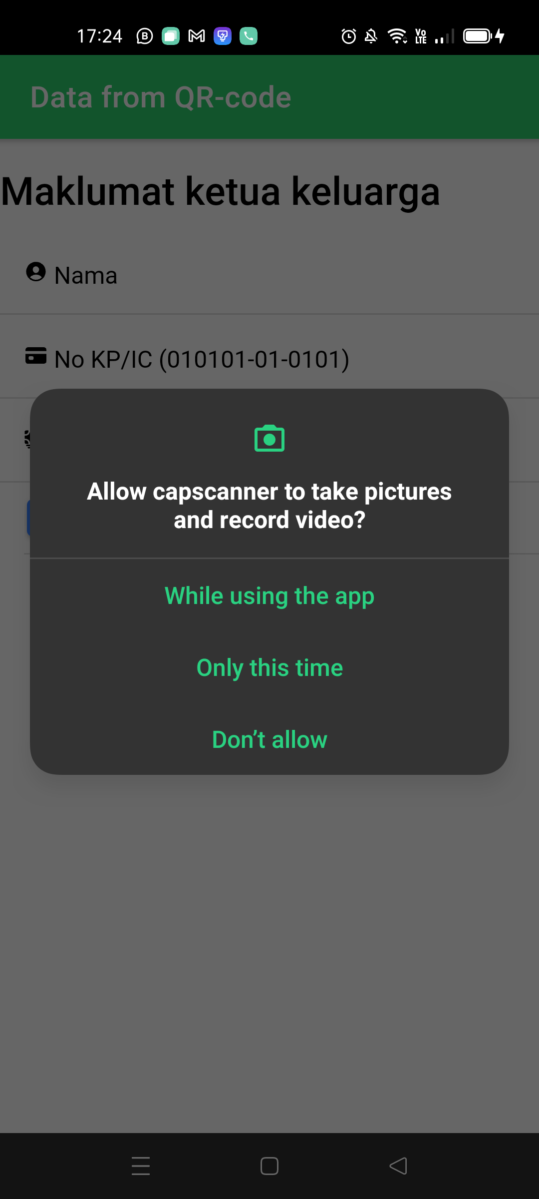
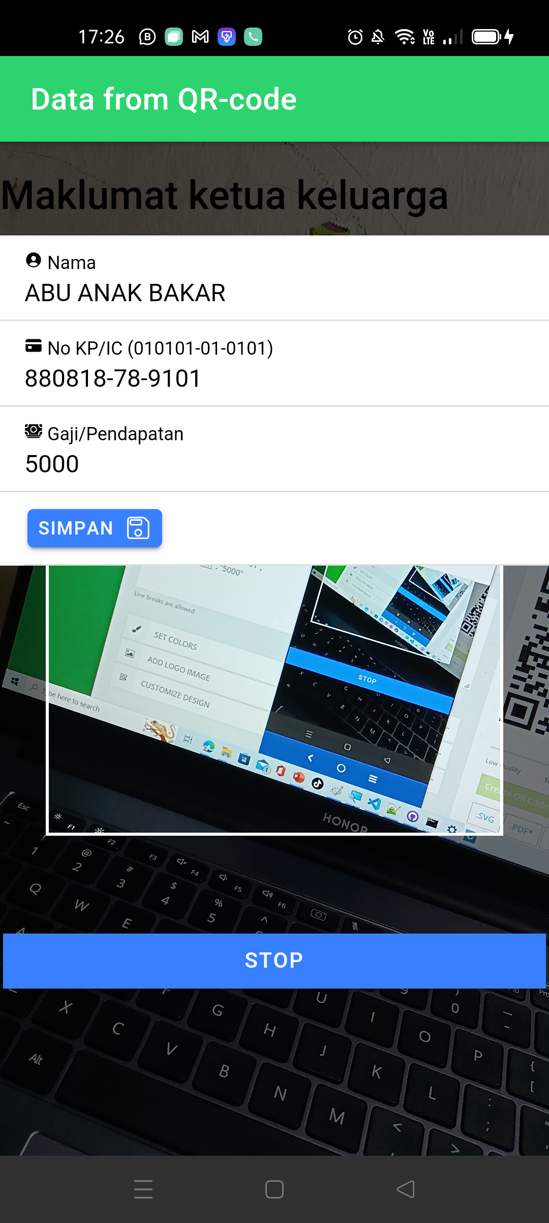
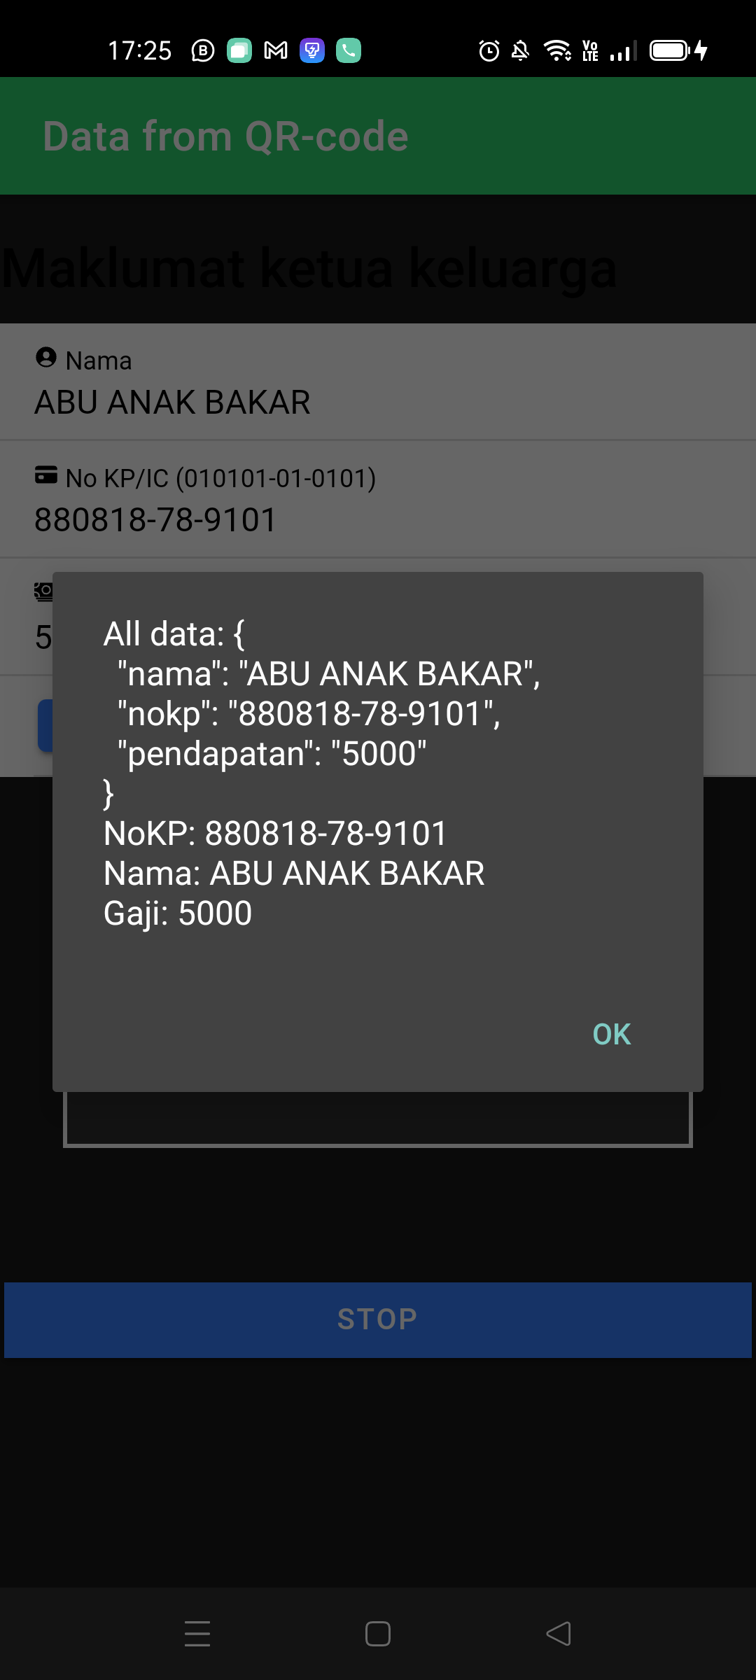
Output Preview

Slide 4
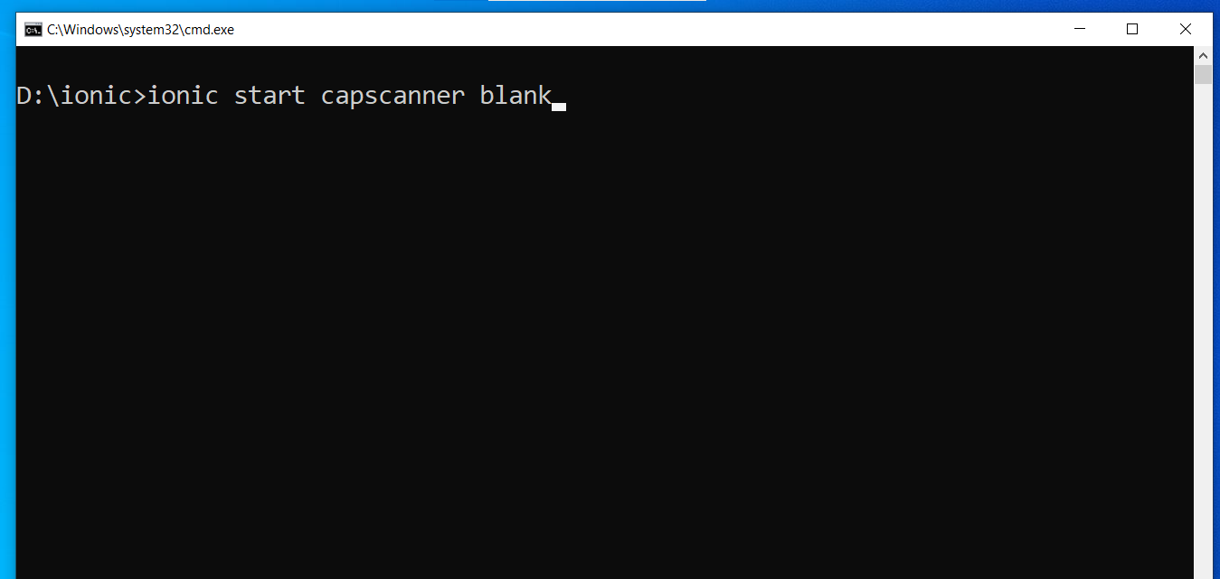
Create new Ionic Project
ionic start capscanner blank

Slide 5
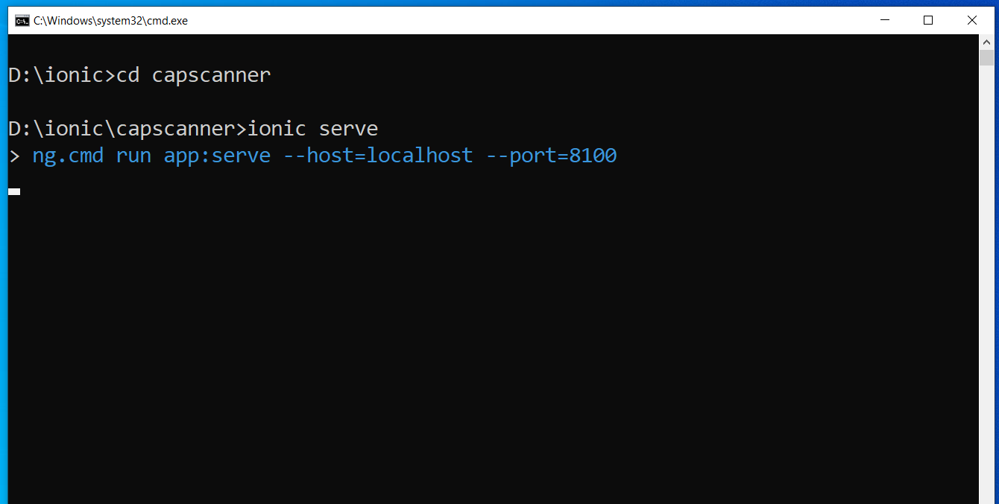
Create new Ionic Project
ionic serve

Slide 6

Prepare JSON data in QR-Code
Use something like qrcode-monkey.com

Slide 7
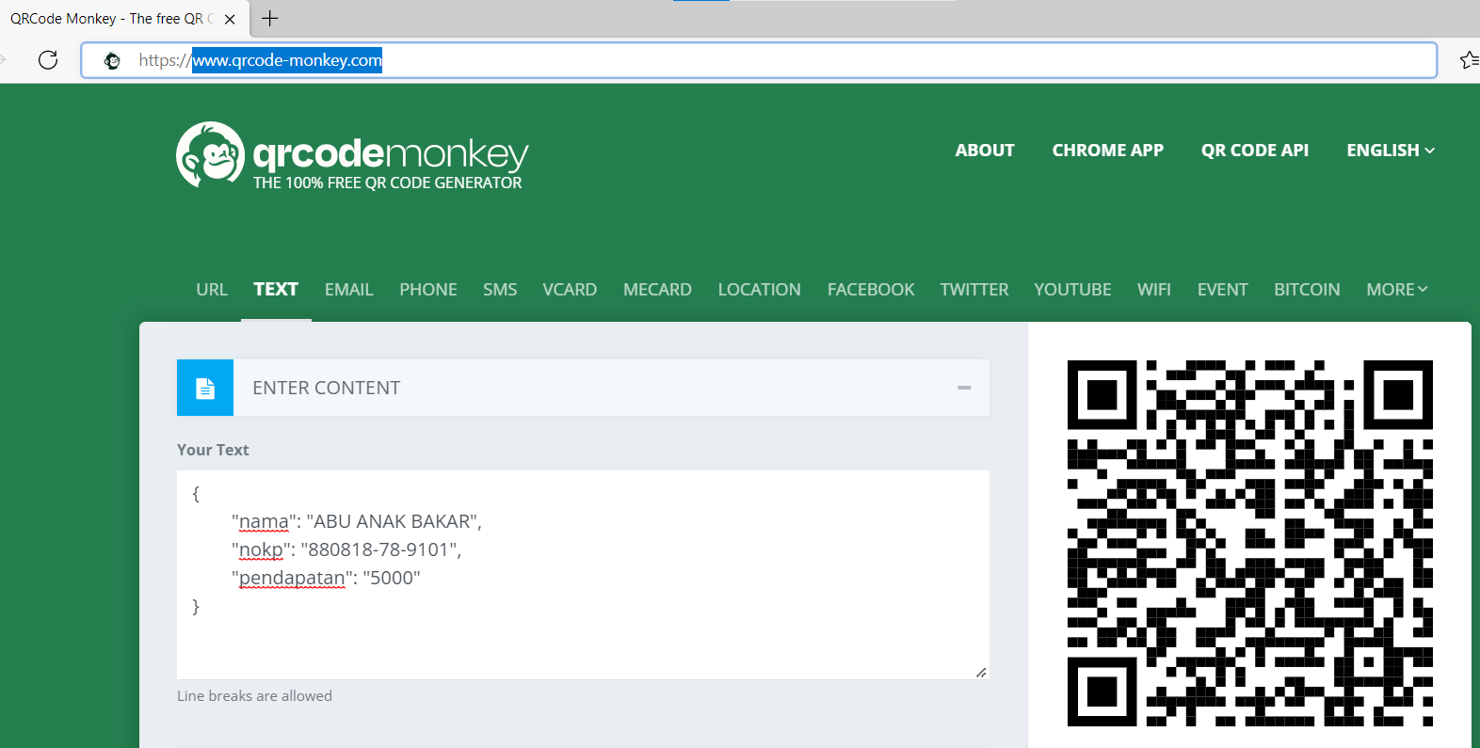
Prepare JSON data in QR-Code
Use something like

Slide 8
Install plugins
npm install @capacitor-community/barcode-scanner
npm install @capacitor/android
ionic cap add android
ionic cap sync

Slide 9
Add Camera on Android Permissions
Go to AndroidManifest.xml

Slide 10
AndroidManifest.xml
Android
>> app
>>>> src
>>>>>> main

Slide 11
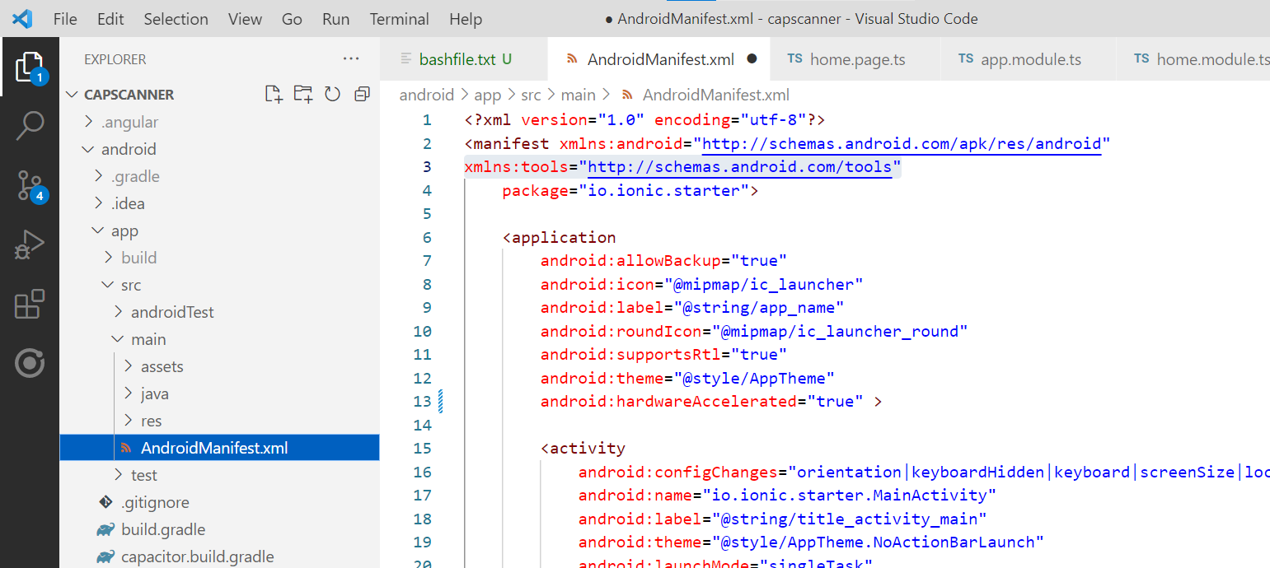
AndroidManifest.xml
Add these lines
>>
>>

Slide 12
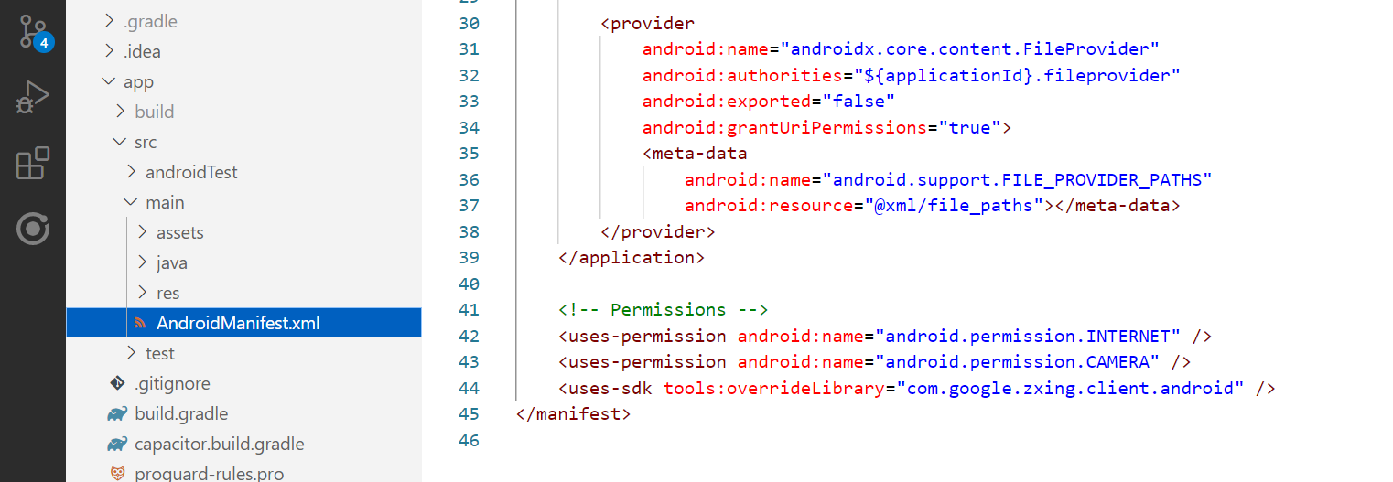
AndroidManifest.xml
And add these lines
>> >>

Slide 13
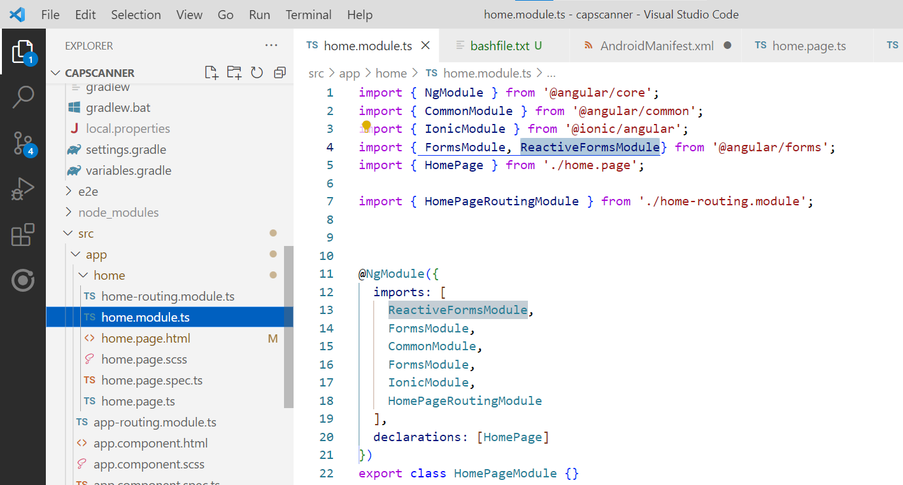
home.module.ts
ReactiveFormsModule

Slide 14
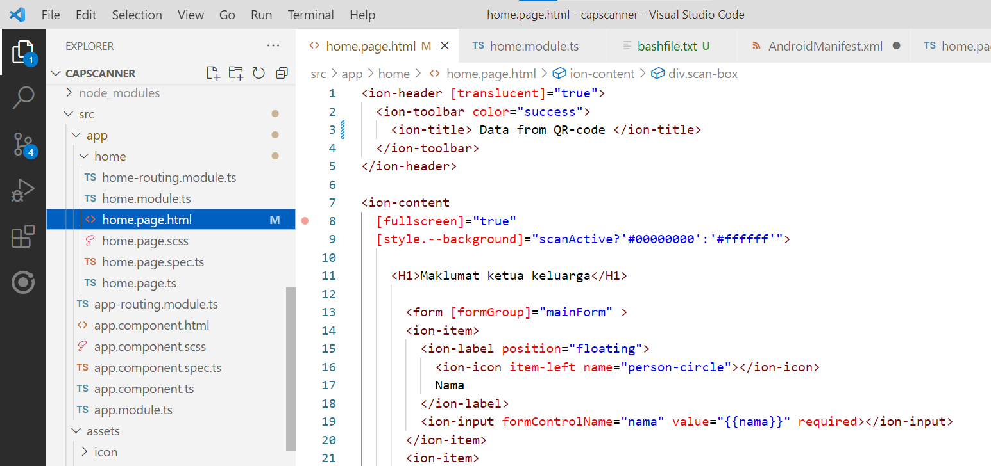
home.page.html
Form Input

Slide 15
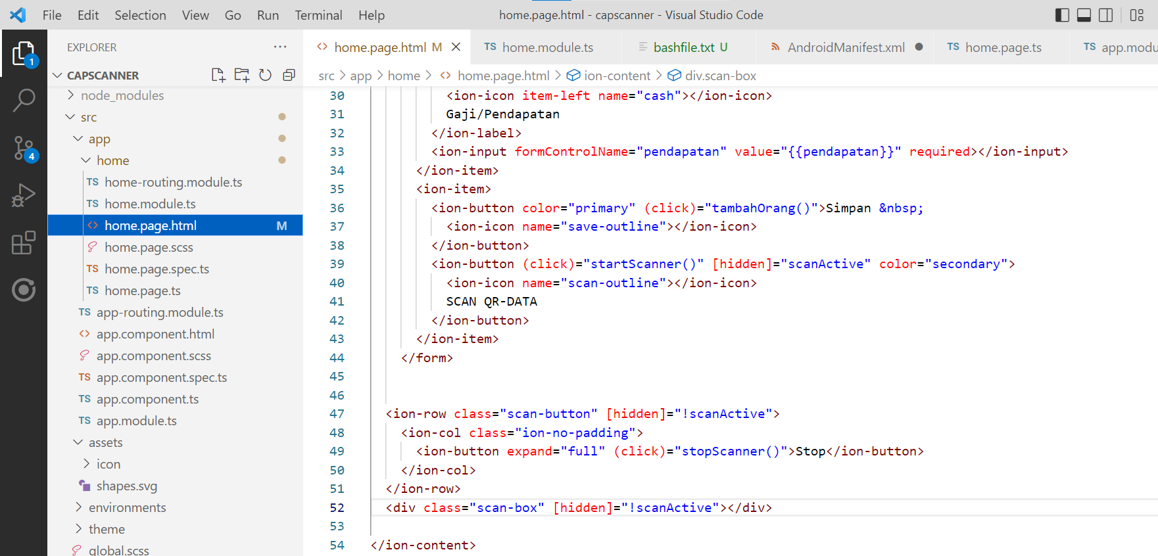
home.page.html
Transparent box container for Camera View

Slide 16
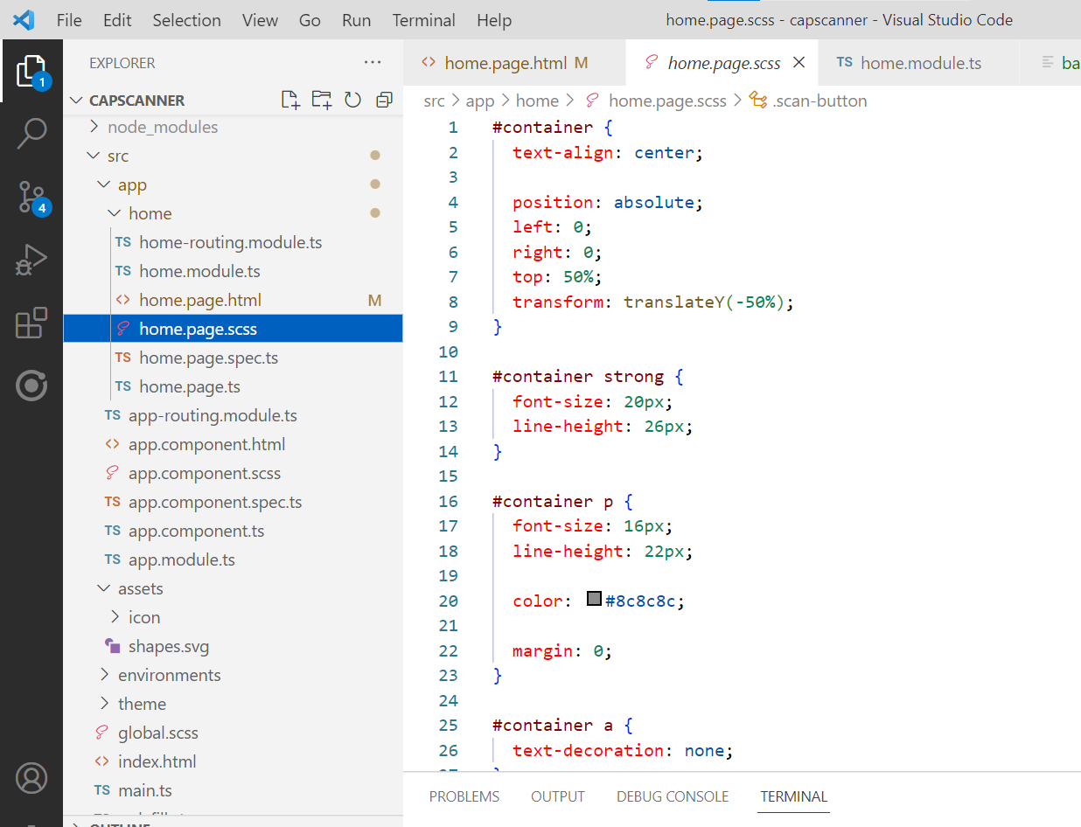
home.page.scss
Transparent box container for Camera View

Slide 17
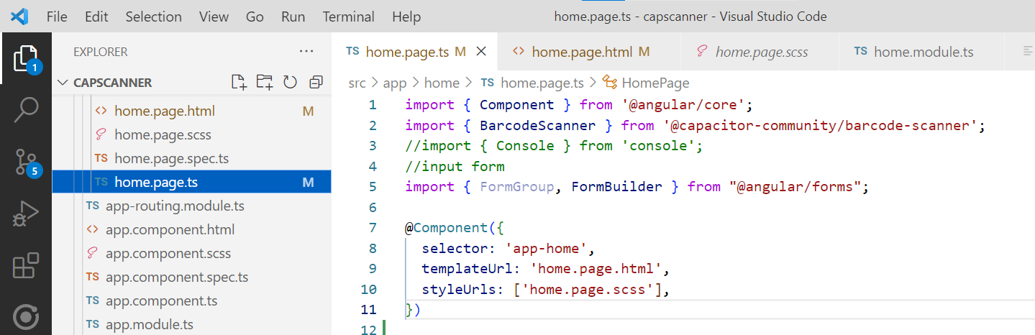
home.page.ts (imports)

Slide 18
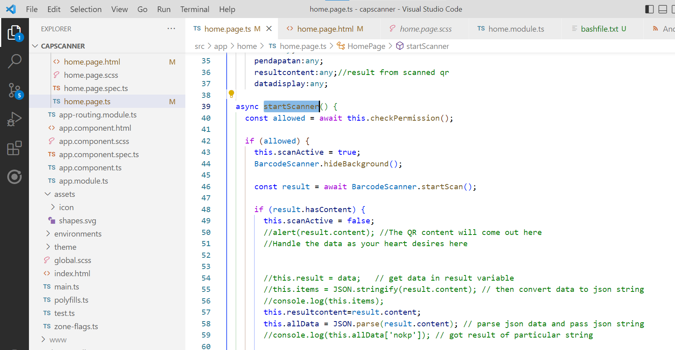
home.page.ts (startScanner function)

Slide 19
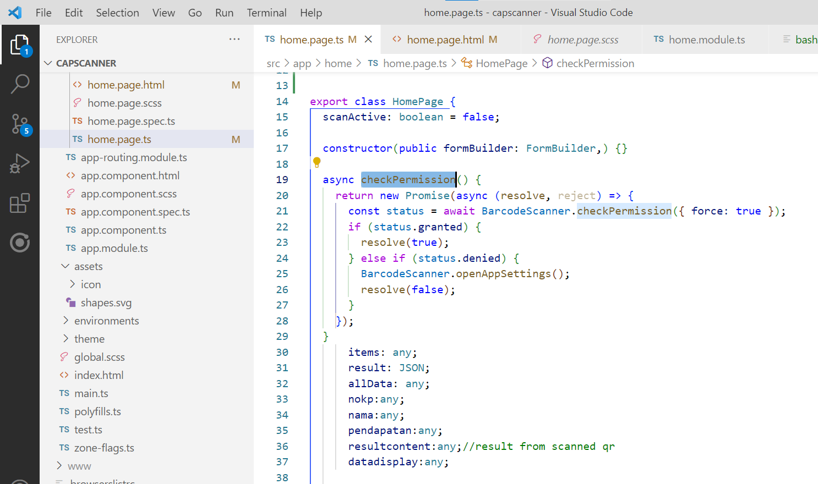
home.page.ts (check permission)

Slide 20
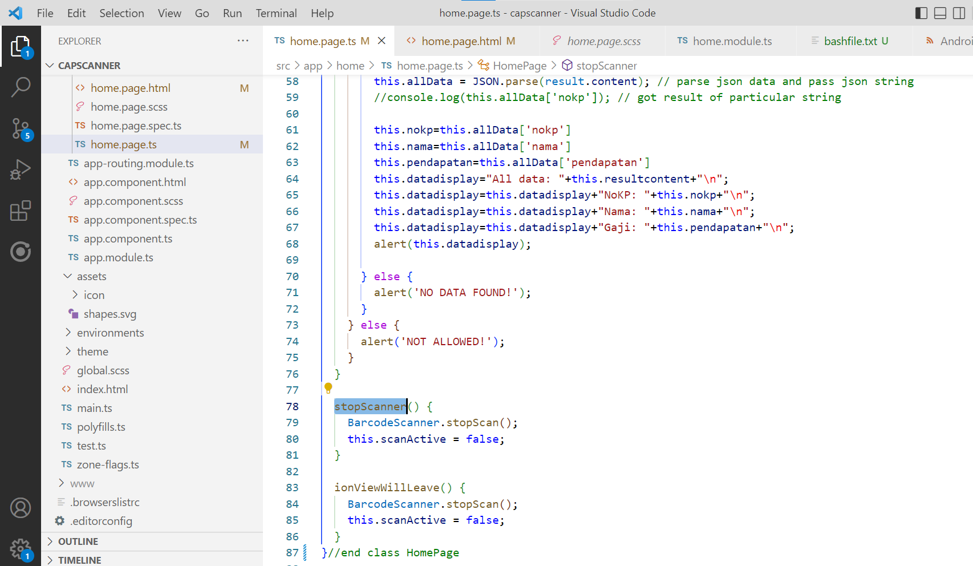
home.page.ts (stopScanner function)

Slide 21
Test app
ionic build
ionic cap copy
ionic cap run android

